Slide 1
C程式設計實驗(二)
Chapter14. Inheritance

Slide 2
Inheritance Basics
New class inherited from another class
Base class
"General" class from which others derive
Derived class
New class
Automatically has base class’s member variables & member functions
Can add additional member functions and variables

Slide 3
Derived Classes
Example: Class of "Employees"
Composed of:
Salaried employees
Hourly employees
Each is a "subset" of employees
Another might be those paid fixed wages each month or week
Employees
Base
Salaried Employees
Hourly Employees
Derived

Slide 4
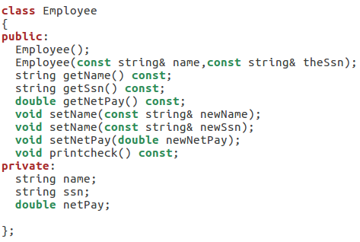
Employee class

Slide 5
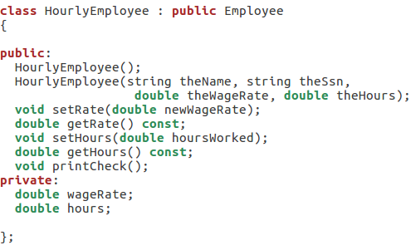
HourlyEmployee class
Derived class
Base class

Slide 6
Redefining
The base class’s definition isn’t "lost"
Can specify its use: Employee JaneE; HourlyEmployee SallyH; JaneE.printCheck(); → calls Employee’s printCheck function SallyH.printCheck(); → calls HourlyEmployee printCheck function SallyH.Employee::printCheck(); → Calls Employee’s printCheck function!
Not typical here, but useful sometimes

Slide 7
Redefining vs. Overloading
Redefining in a derived class:
SAME parameter list
Essentially "re-writes" the same function
Overloading:
Different parameter list
Defined a "new" function that takes different parameters
Overloaded functions must have different signatures

Slide 8
Constructors in Derived Classes
Base class constructors are NOT inherited in derived classes!
But they can be invoked within the derived class constructor
Which is all we need!
Base class constructor must initialize all base class member variables
Those inherited by the derived class
So derived class constructor simply calls it

Slide 9
Derived Class Constructor Example
Consider syntax for HourlyEmployee constructor: HourlyEmployee::HourlyEmployee(string theName, string theNumber,
double theWageRate, double theHours) : Employee(theName, theNumber),
wageRate(theWageRate), hours(theHours){ //Deliberately empty }

Slide 10
Constructor: No Base Class Call
Derived class constructor should always invoke one of the base class’s constructors
If you don’t:
Default base class constructor automatically called

Slide 11
Pitfall: Base Class Private Data
Derived class “inherits” private member variables
But still cannot directly access them
Not even through derived class member functions!
Private member variables can ONLY be accessed "by name" in member functions of the class they’re defined in

Slide 12
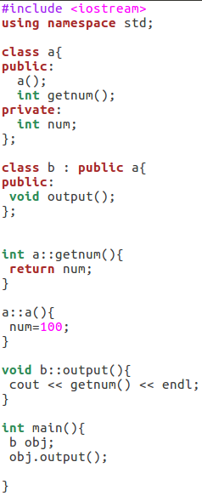

Example

Slide 13
The protected:
New classification of class members
Allows access "by the name" in the derived class
But nowhere else
Still no access "by the name” in other classes
In class it’s defined → acts like private
Considered “protected” in the derived class
To allow future derivations

Slide 14
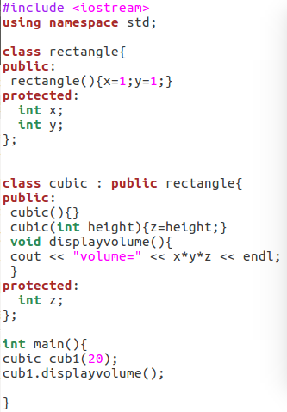

Example

Slide 15
Inheritance
Access specifier In base class | Type of inheritance
 | public | protected | private
public | public | protected | private
protected | protected | protected | private
private | inaccessible | inaccessible | inaccessible

